Slide 1
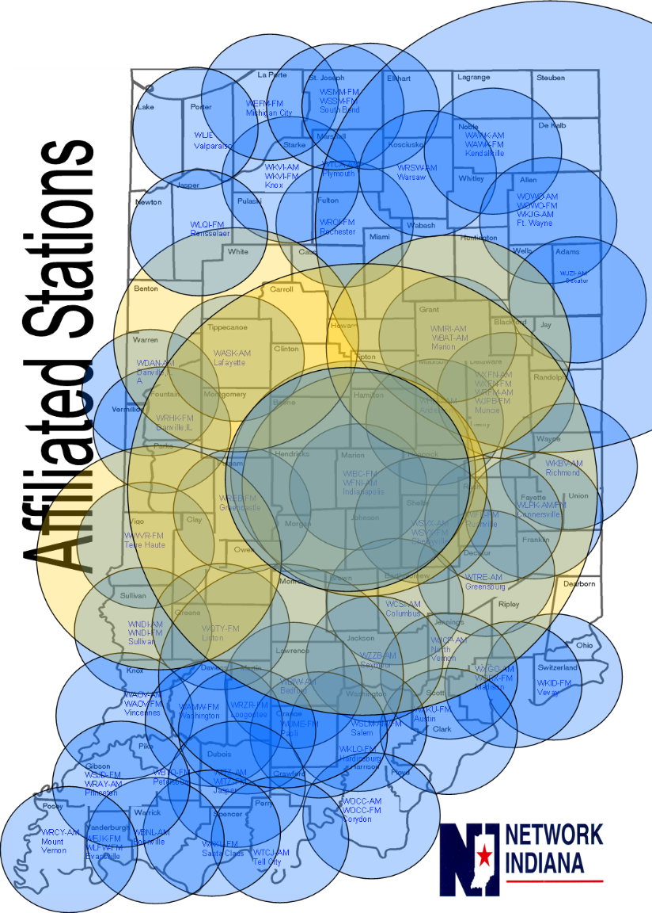
A Statewide “Base Buy”
With a weekly listenership of over 1.7 million (Nielsen national Regional Database Fall 2017), buyers & advertisers know they’ll reach 25% of Hooisers when advertising on Network Indiana Plus stations. All ads air 6am-7pm.
Buying is Easy-Peasy!
Advertisers air on 68 stations, reach the entire state, and still handle only:
ONE ORDER
ONE MP3
ONE INVOICE
ONE CHECK

