Slide 1
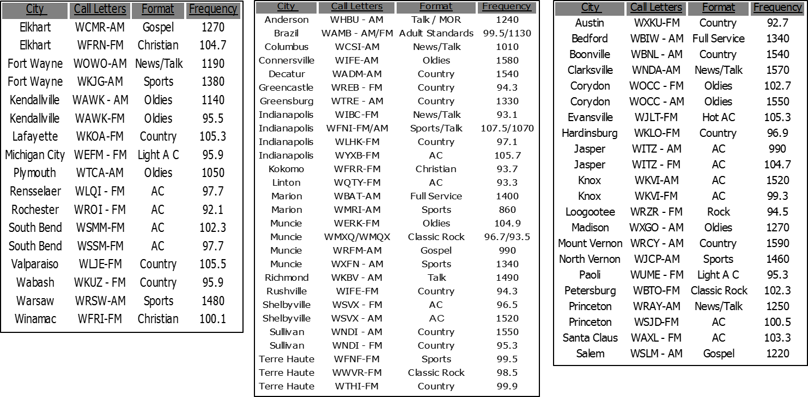
Network Indiana Plus Affiliates List
North, Central & South Regions
Heard in all 92 counties, Network Indiana delivers all major metros plus hard to reach rural communities.
Now with new technology, advertisers can provide different creative to specific regions of Indiana.
This can be a big benefit to state government agencies!

