Slide 1
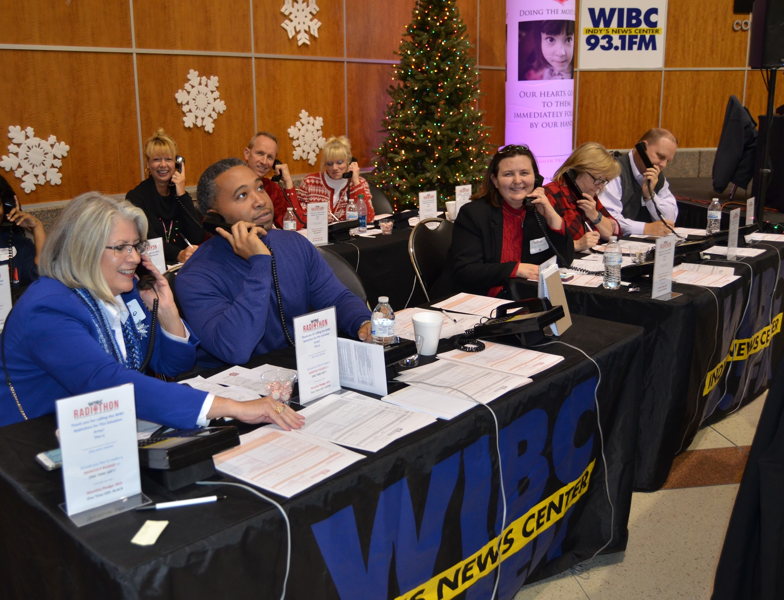
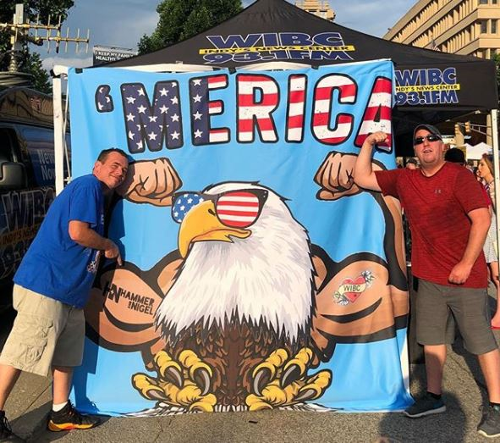
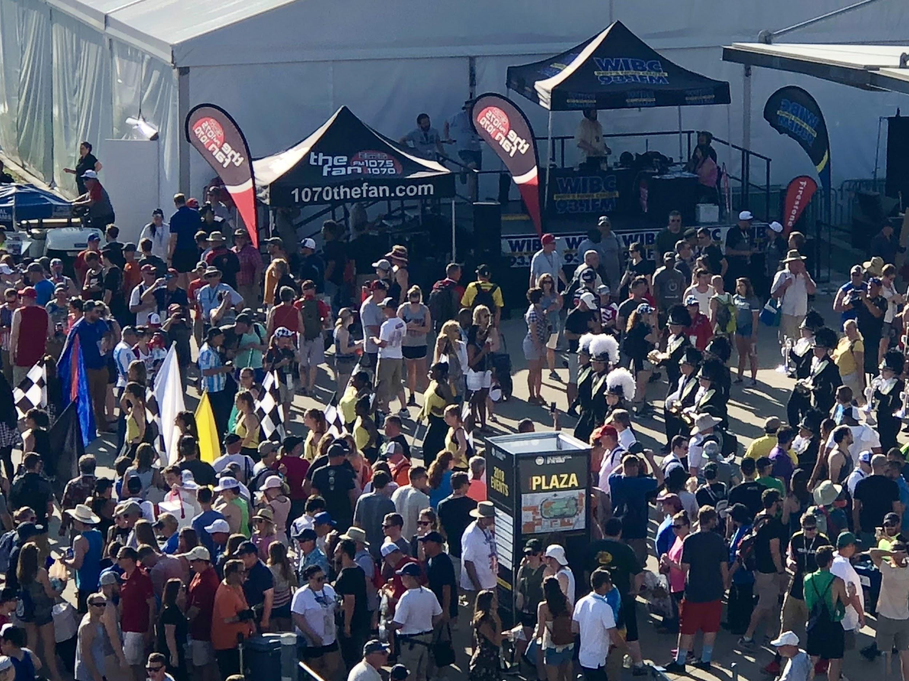
COMMUNITY AND PROMOTIONAL ENGAGEMENT
Each holiday season WIBC hosts a Radiothon benefitting the Salvation Army of Central Indiana. Since 1994, we’ve raised more than $4,000,000!
WIBC’s Tony Katz hosts #DonutDayIndy each year on Monument Circle - passing out thousands of free donuts with the Salvation Army.
For over 60 years WIBC has been the flagship station for the running of the Indianapolis 500
The WIBC brand is represented at over 275 events throughout Central Indiana each calendar year

