Slide 1
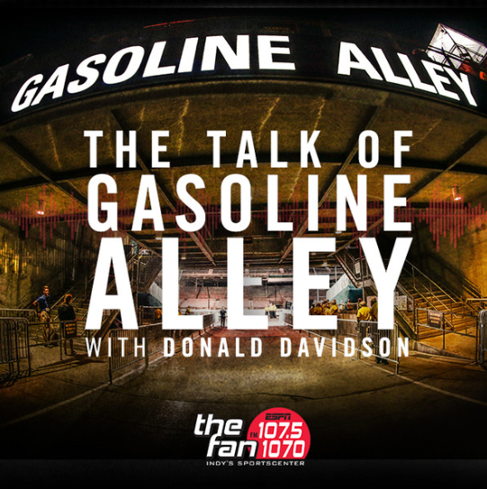
Talk of Gasoline Alley
Indianapolis Motor Speedway Historian Donald Davidson answers your questions of a nostalgic nature about the Indianapolis Motor Speedway on 107.5/1070 The Fan. The program airs live from 8-9pm on weeknights and 6-8pm on weekends throughout the month of May.
Click here to find podcasts of Talk of Gasoline Alley

