Slide 1
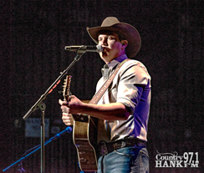
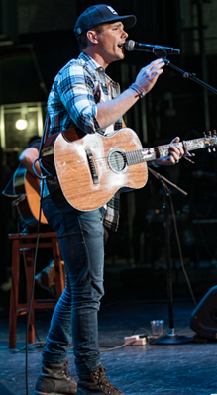
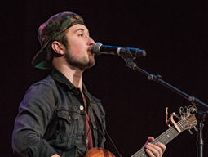
HANKFEST returned for the 5th year this fall! The 2018 show was SOLD OUT! Hankfest is held at the Murat Theatre at Old National Centre on
HANK produces this show as a way for us to give back to our listeners and also give them a chance to see, and possibly meet, the next breakthrough artist! We’ve done this by giving away THOUSANDS of FREE tickets at multiple ticket stops throughout the Indianapolis metro area.

