Slide 1
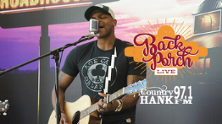
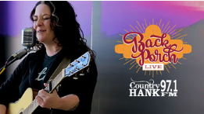
Back Porch Live
Country 97.1 Hank FM is always looking for exciting ways to interact with new artists! Join us for a Back Porch Live here at our studios on Monument Circle.
Check out all the Back Porch Live performances on HANKFM.com

