Slide 1
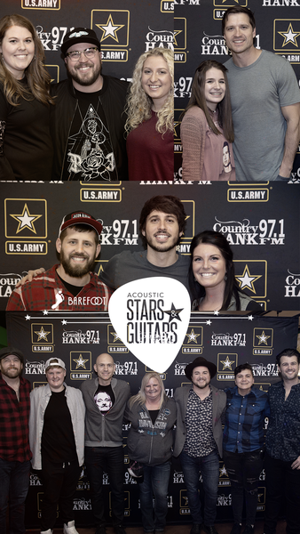
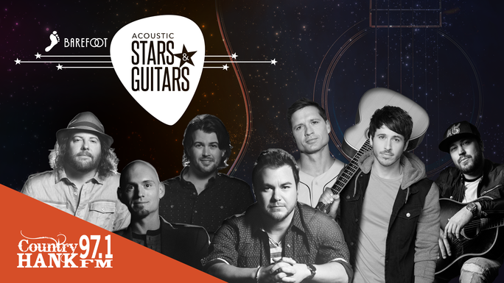
2019 marked our 3rd annual Acoustic Stars & Guitars with performances by:
Eli Young Band
Morgan Evans
Mitchell Tenpenny
Walker Hayes
HANK loves this concert because it gives our listeners an intimate, one-of-a-kind acoustic experience, featuring of a variety country artists on one stage together for one night only. During the show the artists take turns playing their biggest hits and telling stories behind the music.

